Slide 1



Come Celebrate
With Us!
(Insert event details)
The fun begins on
(insert day/date)
from (insert starting and ending times)
in the (insert event location).
Hope to see you there!

Slide 2
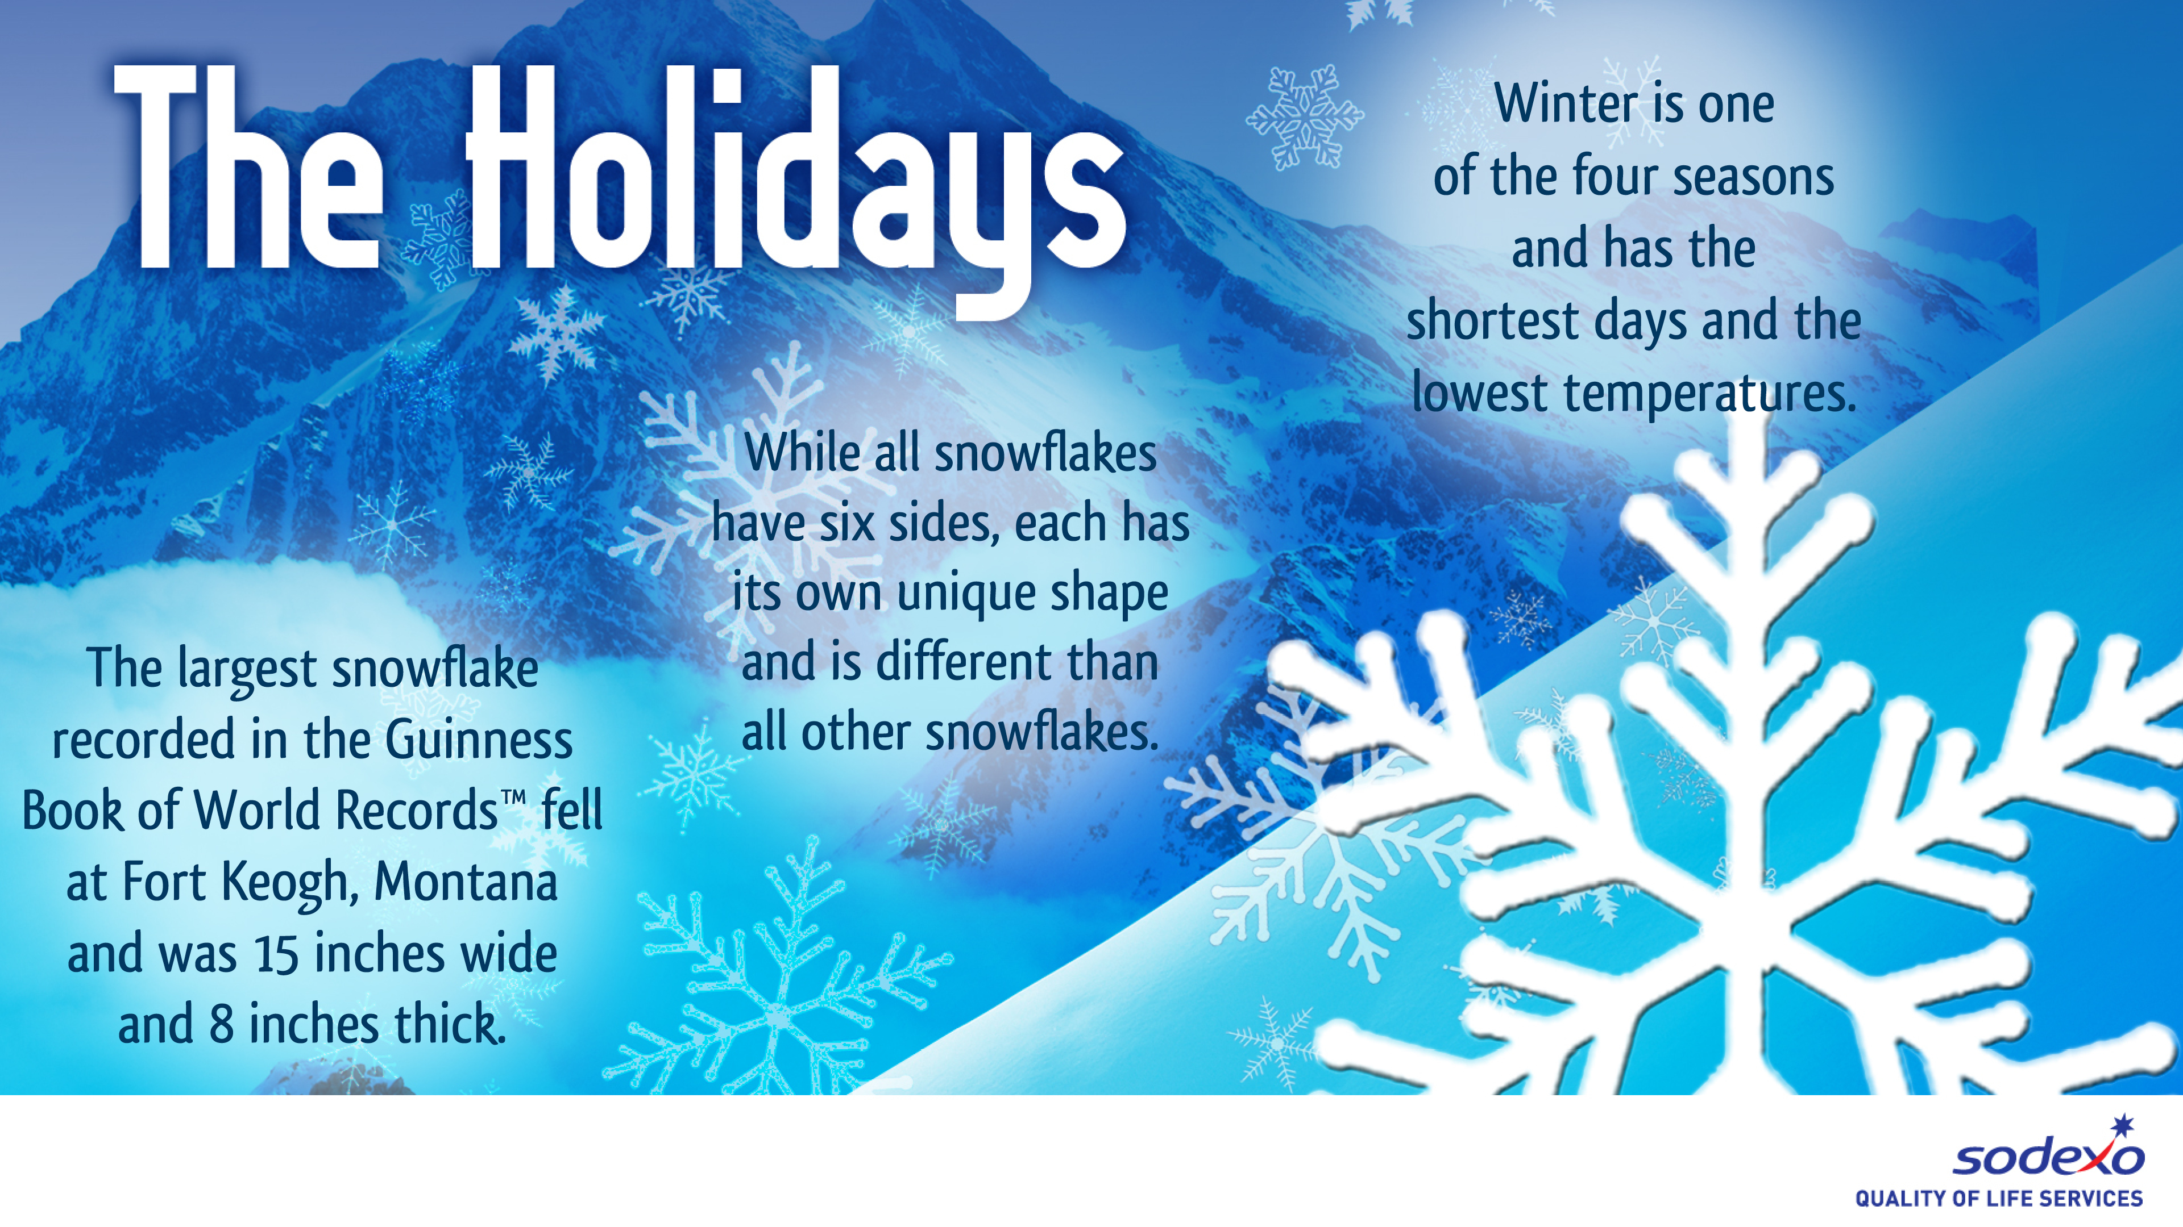
Winter is one of the 4 seasons and has the shortest days and lowest temperatures.
The largest snowflake in the Guinness Book of World RecordsTM fell at Fort Keppgh, Montana and was 15 inches wide and 8 inches thick.
While all snowflakes have 6 sides, each has its own unique shape and is different than all other snowflakes.

